Slide 1
Software Carpentry When you arrive…
Please fill in the pre-assessment workshop survey if you haven’t already
http://bit.ly/SWCPreSurveyNov2017
Go to the shared Etherpad and follow the set up instructions
http://bit.ly/EtherNov17

Slide 2
Software Carpentry
Southampton – Old Thorns Manor Hotel
November 8-9 2017
Alistair Bailey, Arshad Emmambux, Steve Crouch, John Robinson
Notes:
Cabaret config
Been involved with Software Carpentry since 2012
Taught at 13 Software Carpentry workshops
And also train up new instructors for Software and Data Carpentry

Slide 3
Housekeeping
No scheduled fire drills today!
Pre-alarm for staff, but continuous ring means evacuate
Evacuation route
Out door, to the right, down stairs to fire exit
Secondary exit out door to the right, downstairs from balcony
Meet in car park
Toilets – bar area downstairs on left, near the stairs
Tea, coffee, pastries provided at breaks!

Slide 4
Why are we here?

Slide 5
Researchers who write software!
Confess!
Who’s main job isn’t producing code/software (e.g. researcher)?
Who writes software to support research?
Who would find it impractical or impossible to do their main job without writing software?
Notes:
So writing software is important in what we do…
It’s a means to an end – software is a tool to generate or discover a result to publish.
But so is the practice of doing ‘science’ in general!
We just use different tools to get a result.
In pharmacology, have strict protocols to follow in the lab.
Why not with developing software?
They both produce results, doesn’t software deserve the same attention?
So why is it that the practice of developing software
isn’t given the same attention as the practice of ‘science’?

Slide 6
We should care about software!
100%
92%
69%
50%
56%
0%
Use software
Fundamental to results
Develop own code
Notes:
And we should care about the software that underpins research!
From survey conducted by SSI of researchers at 15 Russell Group universities in 2014,
To find out about their software use and background.
Perhaps 220,000 researchers in the UK…
417 respondents. Whilst
- 92% of researchers said they use software in their research,
- and 69% that it’s fundamental to their results,
- and over half of their time is spent developing code,
90% have learned software development skills themselves.
That’s potentially a lot of people writing code!
That code generates results!
Results go into papers!
Papers are important!
Ergo, software is important!
And that's why we're here today.
We want to be better at writing software, and learn some cool stuff along the way.

Slide 7
Who are we?

Slide 8
To help you learninate…
Instructors
Alistair Bailey
Arshad Emmambux
Steve Crouch
John Robinson
Helpers
Dan Locke
James Richings
James Graham

Slide 9
Research Software Group
www.rsg.soton.ac.uk
Based in Electronics and Computer Science
We help to improve software developed by researchers at Southampton, through:
Direct collaboration: we provide skilled Research Software Engineers for projects
Software development skills training: through Software & Data Carpentry workshops
Led by Simon Hettrick & John Robinson
Contact
rsg-info@soton.ac.uk
Notes:
RSG led by SH and JR,
Based in Electronics and Computer Science
We hire out our software engineers across the University
Any faculty, any discipline
You can hire us to help you!

Slide 10

Software Sustainability Institute
Cultivate world-class research with software
Notes:
At a national level…
Also help people improve their software and how they develop it,
and train others
Also assigned coordinator for SWC and DC in the UK
But also investigate issues related to software more generally...
- Run events to look into these issues
- Work in policy – recognition for Research Software Engineers

Slide 11
What are we going to learn?

Slide 12
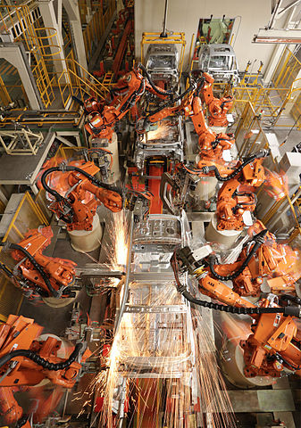
Automation
Bash Shell
Not just about learning commands
Learning just a few things can make a huge difference
Image Zen Wave CC-BY-SA
Notes:
How to do repetitive tasks automatically…
Not just about learning commands:
Going to teach a basic working understanding of the shell
Core things like the filesystem, what happens when you run a program
A few things:
Hard things that took hours become easy
[learner story]
Participant whose work was transformed by what they learnt they could do with Bash.

Slide 13
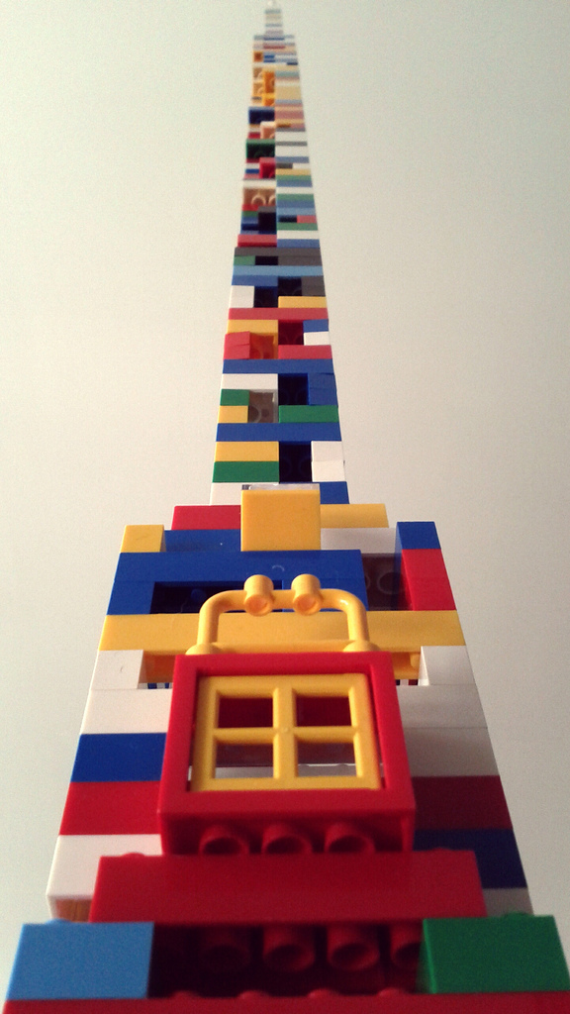
Python
Beyond syntax…
How to build programs step-by-step
Comprehensive, reusable, testable
Image Charles Kenny CC-BY-SA
Notes:
A lot of the time you need more flexibility, granularity, control over processing
that the shell can’t really provide
Beyond syntax:
- Want to teach core skills you can apply after the workshop
- So teach by working example, not abstract lectures
Show how to build programs step-by-step:
- Going to use a basic climate modelling example based on real data
- Slowly build a program over time to process this data
As we go, teach how to build code that is
- Understandable (and reusable) by others
- Code comments, when and how to do it
- Modularity – as program grows, when and how do you start breaking down the
Program into separate functions and modules?

Slide 14
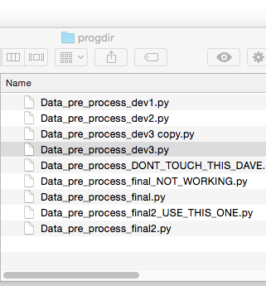
Version Control
Git
How has this code changed?
Who made this change?
Which version of this code was used to generate this result?
Notes:
A place to store and manage software code
Q: who here uses version control to develop software?
Avoid ‘dead laptop, lost code’ syndrome,
But it goes much further
It stores a complete history of software as it’s been developed over time
Can really help to overcome the situation commonly faced on the right...
Lightning talk at the Software Sustainabilty Institute’s annual CW earlier this year
- Andrew Walker
- Just one of many examples
- Did talk as message to his former self 10 years ago
- Along with modular design and automation -- version control!!!
- When you know it, and use it, you can’t live without it!
Real power is when you work as part of a team
- (Answering these questions…)

Slide 15
Agenda
10:15-13:00 Automating tasks with the Bash shell
(Alistair) 11:00-11:20 Break
13:00-14:00 Lunch
14:00-16:45 Building programs with Python
(Arshad) 15:00-15:15 Break
16:45-17:00 Wrap-up

Slide 16
Agenda
10:00-13:00 Writing robust code and unit testing with Python
(Steve) 11:00-11:20 Break
13:00-14:00 Lunch
14:00-16:45 Version control with Git
(John) 15:00-15:20 Break
16:45-17:00 Wrap-up

Slide 17
Some final words…

Slide 18
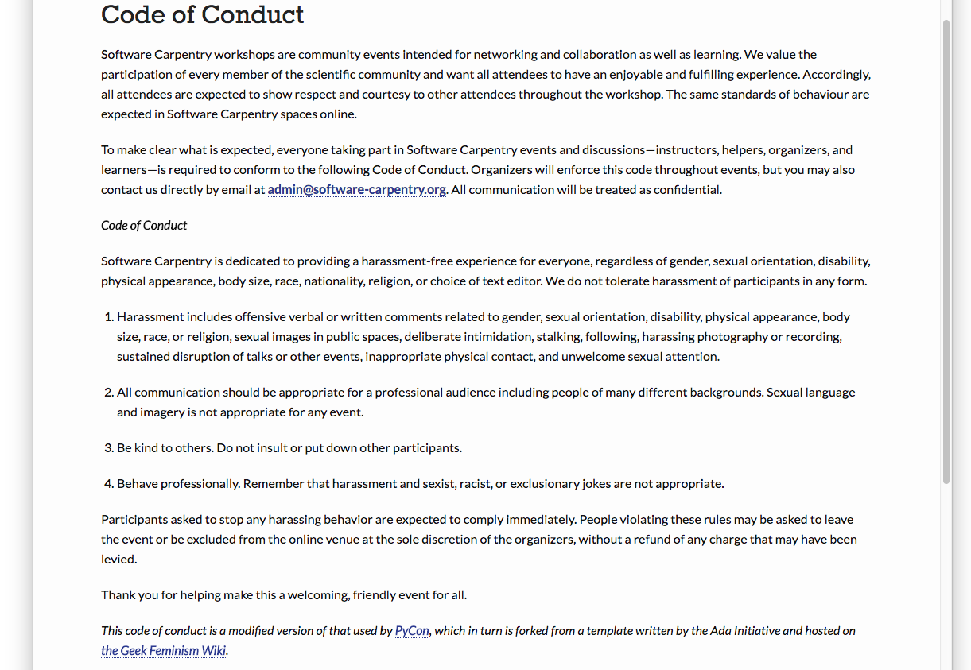
Code of Conduct
http://software-carpentry.org/conduct/
Notes:
Don’t harass people
Communicate appropriately
Be polite
Be a professional

Slide 19
Need help?
John Wiechecki
Say hi to your neighbours!

Slide 20
Need help?
Michael Arrighi
Sticky notes

Slide 21
Need help?
Benjamin Reay
Ask the group in Etherpad
http://bit.ly/EtherNov17

Slide 22
That’s all from me…
…but for you, just the beginning!

Slide 23
Software Carpentry Day 2 When you arrive…
Please check you can do the following…
Open a terminal as we did yesterday
Ensure you are in the 2017-11-08-southampton-swc/novice/python directory (where we left you yesterday)
$ cd 2017-11-08-southampton-swc/novice/python
Run the Python interpreter as we did yesterday...
$ python
At the >>> prompt…
>>> import numpy
>>> import matplotlib
(The second one may take some time!)
If you encounter any errors, please seek a helper

